Slide 1
CS626: Project Discussion
Tweet Classification for Crisis Response
Singamsetty Sandeep, 213050064
Anmol Namdev, 213050044
Sakharam Sahadeo Gawade, 213050027
27 November 2021

Slide 2
Motivation
Twitter is medium where information is shared in a concise manner.
Critical Information and Insights can be gained from the tweets which can be used to make a speedy rescue plan.
For this it is not just important to know if the tweets are related to a disaster or not but also to distinguish between critical and non critical tweets.

Slide 3
Problem Statement
Classification of Crisis Tweets
Training SVM models and comparing them across different disasters and an aggregated dataset
Input: Tweets
Output(Binary-class classification):
Critical
Not Critical
Examples:
1. NO #earthquake or #tremors in #Bengaluru, say #disaster monitoring centre after a loud #sound was reported in some areas. - Not Critical
2. Massive floods in Chittoor district of Andhra Pradesh. Heavy rains lashing parts of the region including Tirupathi. - Critical
3. 44 dead, 16 missing; 211 villages submerge in Andhra floods - Critical

Slide 4
Supporting Papers (Literature survey)
Identifying and Categorizing Disaster-Related Tweets by Stowe et. al. ,"Proceedings of The Fourth International Workshop on Natural Language Processing for Social Media",2016. ACL
A Sentiment-Aware Contextual Model for Real-Time Disaster Prediction Using Twitter Data by Song et. al., Future Internet, Volume 13, 2021
Deep Learning and Word Embeddings for Tweet Classification for Crisis Response by ALRashdi et al.,The 3rd National Computing Colleges Conference, 2018
Cross-Lingual Disaster-related Multi-label Tweet Classification with Manifold Mixup by Ray Chowdhury et. al., Proceedings of the 58th Annual Meeting of the Association for Computational Linguistics: Student Research Workshop, 2020. ACL
Natural Language Processing to the Rescue?: Extracting “Situational Awareness” Tweets During Mass Emergency, Verma et. al. Proceedings of the Fifth International Conference on Weblogs and Social Media, 2011. AAAI

Slide 5
Data
The data set covers various domains :
Nepal Earthquake, 2015
Chile Earthquake, 2014
California Earthquake, 2014
Pakistan Earthquake, 2013
Cyclone Pam, 2015
Philippines Typhoon Hagupit, 2014
Hurricane Odile Mexico, 2014
Pakistan Floods, 2014
India Floods, 2014
Tweets Statistics:
8515 Earthquake Tweets : 1825 Critical
5276 Hurricane Tweets : 1318 Critical
3589 Flood Tweets : 1494 Critical
When combined:
In the training set
Total No of tweets: 13904
No of critical tweets: 3143
No of non-critical tweets: 10761
In the test set
Total No of tweets: 3476
No of critical tweets: 1494
No of non-critical tweets: 1982

Slide 6
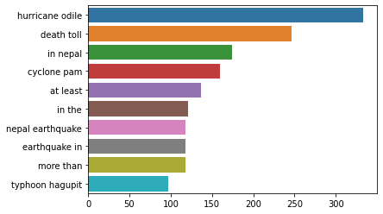
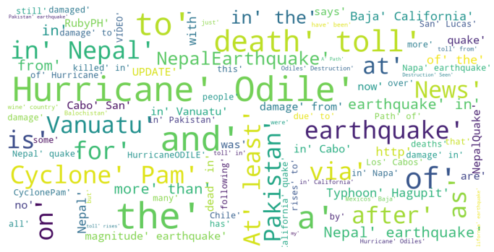
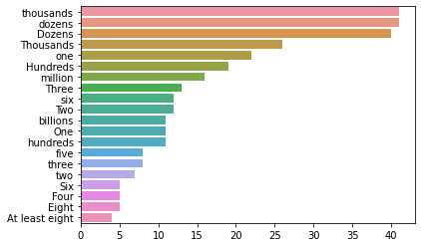
Data
Bigrams in Train-dataset
Entire Data Analysis: https://bit.ly/3rglqNE

Slide 7
Main Technique
SVM with feature engineering
Features:
TF-IDF over verbs, adverbs, adjectives and common nouns
Words describing calamity
Actual Calamity (e.g. “earthquake”, “flood”)
Subsequent Calamities (e.g. “tsunami”, “fire”)
Words describing effects of calamity
Casualties (e.g. “death”, “injury”)
Missing People (e.g. “missing”, “evacuate”, “lost”)
Identifying Intensity (e.g. “dozens”, “thousands”)
Sentiment Score (Using Vader Library)
SVM with BERT Encodings

Slide 8
Contribution
Preparation of derived dataset that can be used for classifying critical tweets
Use of verbs, adverbs, adjectives and common nouns as Features
We have analyzed Data and selected features. ( Feature selection and extraction based on Data composition)
Zero shot learning and Cross Domain Analysis
Usage of sentiment score as a Feature
Analysis of results using the idea of Model Interpretation ( Motivation from LIME )
Pre-processing of tweets ( Fixing out of vocabulary words, removing useless text etc. )
Derived Dataset for critical classification: https://bit.ly/3cWdrwV

Slide 9
Results
1: Critical
0: Non- Critical
SVM - BERT Model trained on Entire data
SVM - TF_IDF and Feature Engineering Model on Entire data
Tested on | Precision |  | Recall |  | F Score |  | Accuracy
 | 0 | 1 | 0 | 1 | 0 | 1
Earthquake | 0.9453 | 0.6893 | 0.8970 | 0.8150 | 0.9205 | 0.7469 | 0.8790
Floods | 0.9582 | 0.7910 | 0.8398 | 0.9431 | 0.8951 | 0.8951 | 0.8802
Hurricane | 0.9495 | 0.7245 | 0.8866 | 0.8635 | 0.9170 | 0.7879 | 0.8807
Combined data | 0.9370 | 0.7038 | 0.8732 | 0.8370 | 0.9040 | 0.7646 | 0.8636
Tested on | Precision |  | Recall |  | F Score |  | Accuracy
 | 0 | 1 | 0 | 1 | 0 | 1
Earthquake | 0.9548 | 0.7118 | 0.9154 | 0.8280 | 0.9347 | 0.7655 | 0.8978
Floods | 0.8444 | 0.8050 | 0.9384 | 0.5953 | 0.8889 | 0.6845 | 0.8357
Hurricane | 0.9333 | 0.7742 | 0.9411 | 0.7500 | 0.9372 | 0.7619 | 0.9006
Combined data | 0.8006 | 0.8816 | 0.9299 | 0.6828 | 0.8604 | 0.7759 | 0.8280

Slide 10
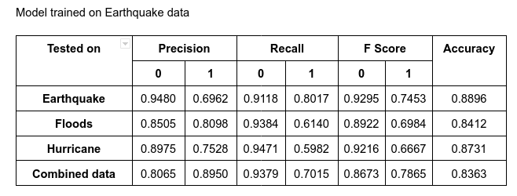
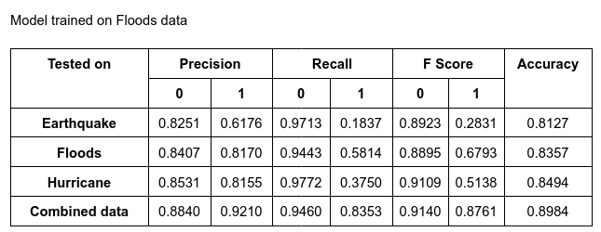
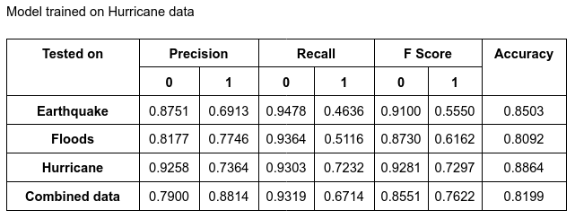
Results
1: Critical
0: Non- Critical
SVM - TF_IDF and Feature Engineering Model trained on Individual Crisis (0 shot learning)
SVM-BERT cross Domain Results: https://bit.ly/3nXOKGC

Slide 11
Analysis of True Positives
Correctly classified
Actual - Critical Predicted - Critical
nepal earthquake deathtoll rises nepalearthquake prayfornepal earthquake
watch incredible drone footage nepals heritage spots shows widespread damage

Slide 12
Analysis of False Positives
Actual - Not-Critical Predicted - Critical
report foreign tourists turning aid workers trekking expeditions converted humanitarian missions
life is so unpredictable allah be wid d families hav lost loved s nepal n indiaallahreham pls
even after damage by earthquake tourists continue visit napa valley

Slide 13
Analysis of False Negatives
Actual - Critical Predicted - Not critical
napa earthquake prompts calls early warning system shut down nuclear plant
quake magnitude has struck northern chile triggering tsunami alert killing least people ( modifying the above tweet as , people died, its being predicted as ‘critical’ )
phones jammed nepal thankfully whatsapp communicating messages

Slide 14
Analysis of True Negatives
Actual - Not-critical Predicted - Not critical
big day nepal people
landslide fears nepal quakes
pakistan earthquake reportedly creates new island

Slide 15
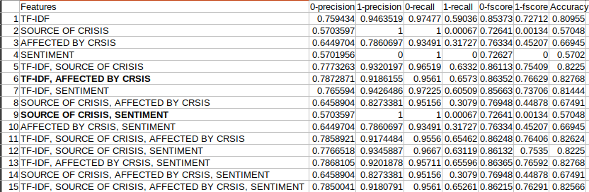
Ablation Study

Slide 16
Conclusion and Future Work
Preprocessing the tweets for spelling mistakes can improve accuracy.
Dealing with Sarcasm is a challenge, identifying sarcasm can help classifying tweets better. ( Please save me, I am dying!! starving since a week, the rats in my neighbourhood are partying with my food #hungry #starving #saveme )
Model trained on combined dataset performed better on individual crisis in comparison to model trained on individual crisis.
Using Deep Learning Models, the accuracy can be improved.
Future Work :
Using SentiBERT + CNN can improve accuracy.

Slide 17
Demo

